Slide 1
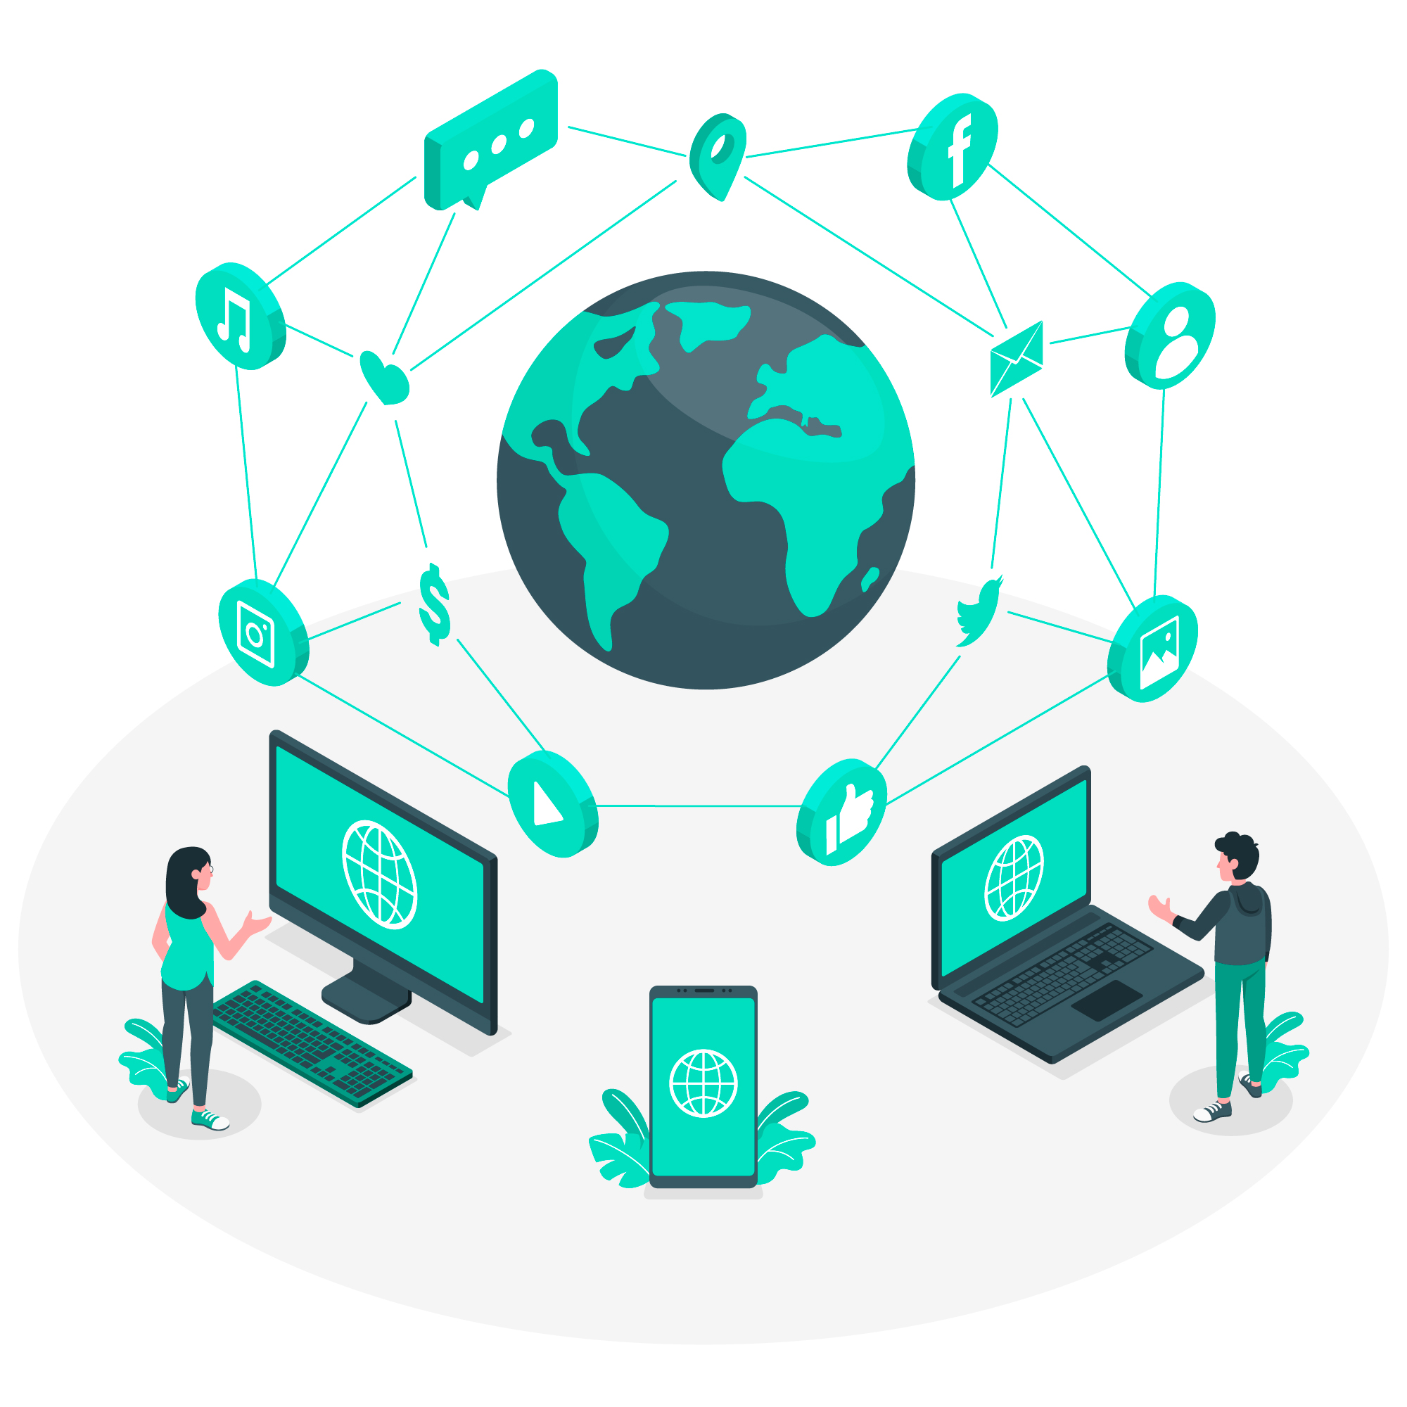
The Internet & The Network
Introduction to Networking
Part -1

Slide 2
Learning Outcomes
Understand the basic concept of the Internet and how it functions as a global network.
Learn what a computer network is and why it’s essential for communication.
Identify different types of networks such as LAN, WAN, and MAN.
Understand the roles of routers, switches, and modems in network communication.
Learn how IP addresses help devices locate each other on a network.
Grasp the concept of data packets and how they move across networks.

Slide 3

What is the Internet ?
The Internet is a global network of computers connected together to share information and resources.
How it Works: It uses a set of rules or protocols (called TCP/IP) to ensure that different devices can communicate, regardless of their location.
Key Idea: The Internet is often referred to as a "network of networks" because it connects many smaller networks (e.g., home networks, business networks, etc.).
Fact: The Internet started in the 1960s as a U.S. military project called ARPANET.

Slide 4
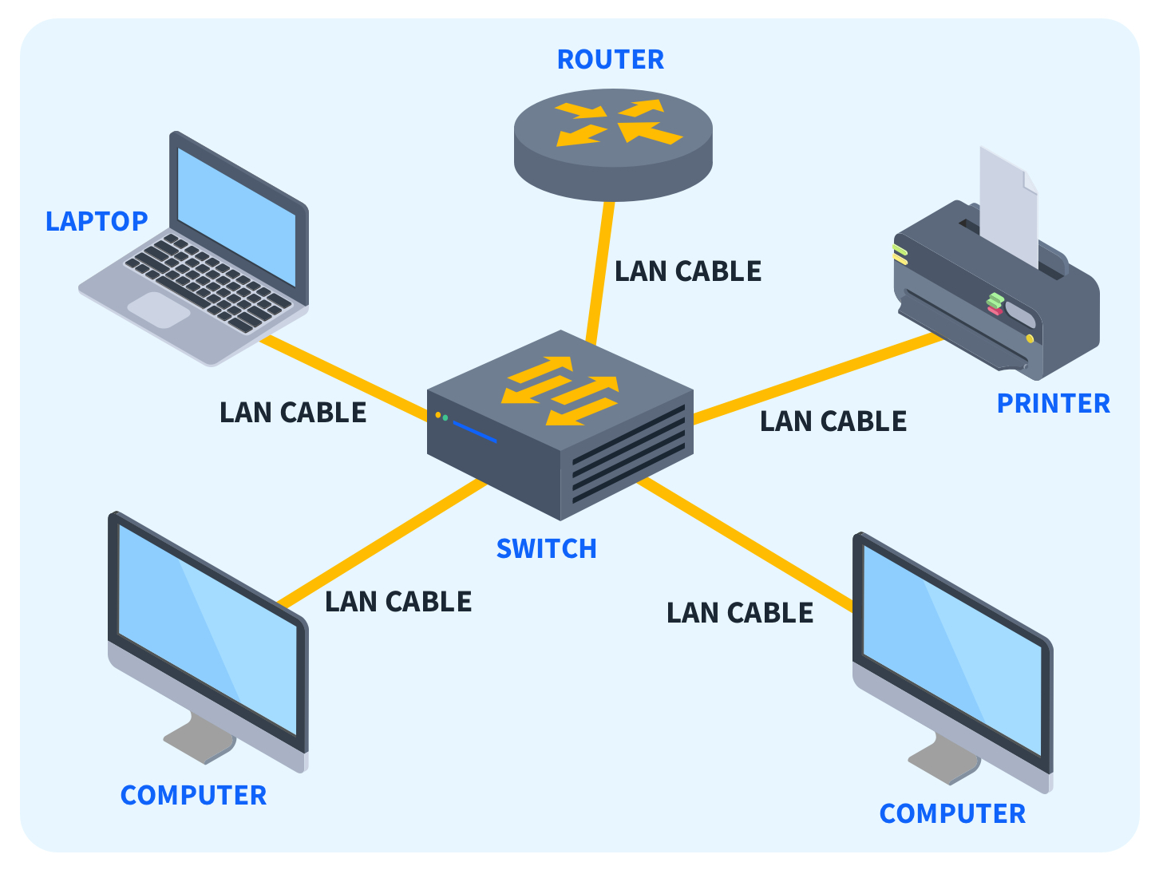
What is a Network ?
A network is a group of two or more computers or devices connected to share resources (like data or printers) and communicate.
Common Devices in Networks:
Computers: Laptops, desktops, servers.
Routers and Switches: Devices that help direct traffic within the network.
Servers: Powerful computers that provide resources, like websites or data, to other devices on the network.
For example : Your school’s computer lab, your home Wi-Fi, and even the network your smartphone uses to connect to the Internet.

Slide 5
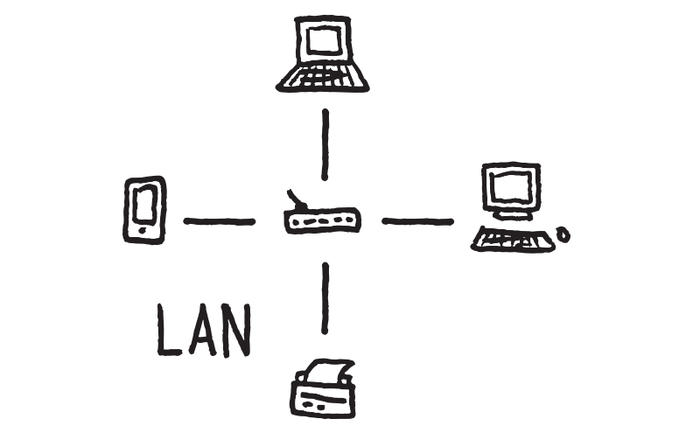
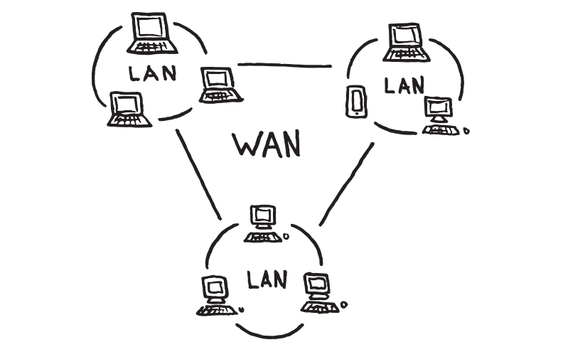
Types of Networks
Local Area Network (LAN):
A network within a small geographic area, like a home, office, or school.
Devices in a LAN can share resources and communicate quickly.
Example: Your school's computer lab network or the Wi-Fi at home.
Wide Area Network (WAN):
A larger network that covers a broad area, like cities, countries, or continents.
The Internet is the largest WAN.
Example: Connecting two offices in different cities through the Internet.
Other Types:
Metropolitan Area Network (MAN): A network covering a city or campus.
Personal Area Network (PAN): A small network around a single person, such as a connection between a smartphone and Bluetooth headphones.

Slide 6
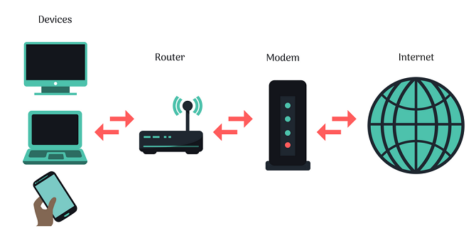
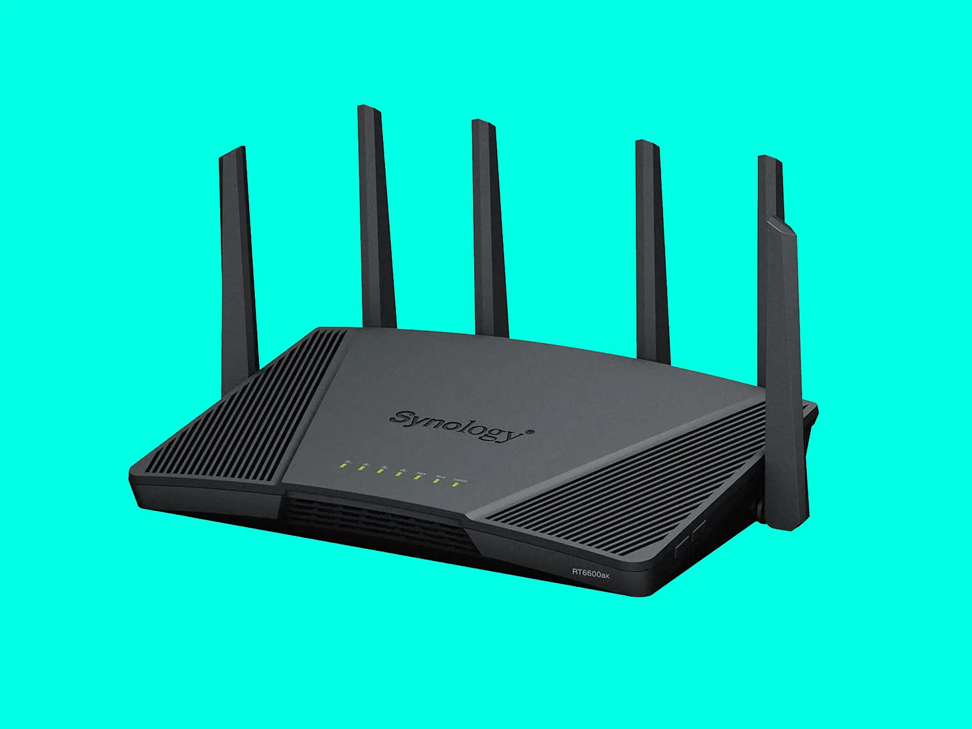
How Networks Connect
Wired Connections:
Computers and devices in a network can be physically connected using cables like Ethernet.
Fast and stable, but limited by the need for physical cables.
Wireless Connections:
Networks can also connect wirelessly using technologies like Wi-Fi or Bluetooth.
More convenient for mobility, but may have slower speeds than wired connections.
Key Devices:
Router: Directs traffic between devices in the network and provides access to the Internet.
Switch: Connects multiple devices within a local network.
Modem: Converts data so it can be sent over communication lines, such as telephone wires or fiber optics.

Slide 7
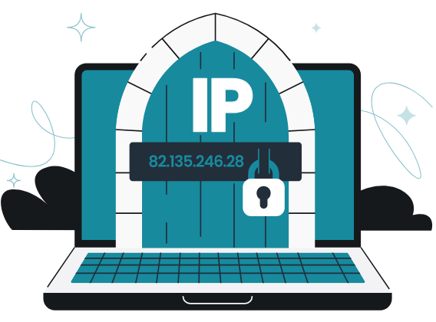
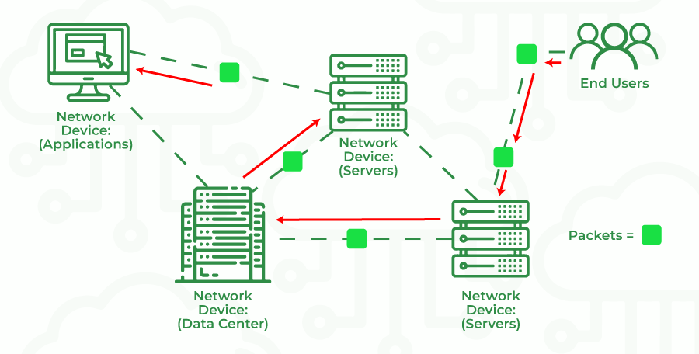
How Do Networks Communicate?
IP Address: Every device in a network has a unique address called an IP Address that helps identify it (like a phone number for computers).
Packets: Information sent over a network is broken down into small chunks called data packets. Each packet travels separately and is reassembled at the destination.
Protocols: Rules that devices follow to communicate. The most common one is TCP/IP, which ensures that data gets to the right place, even over the Internet.
Routers: They decide the best route for packets to travel across the network and Internet.
For example: When you send a message to a friend, the message gets broken into packets, sent over different routes, and reassembled when it reaches your friend’s device.

Slide 8
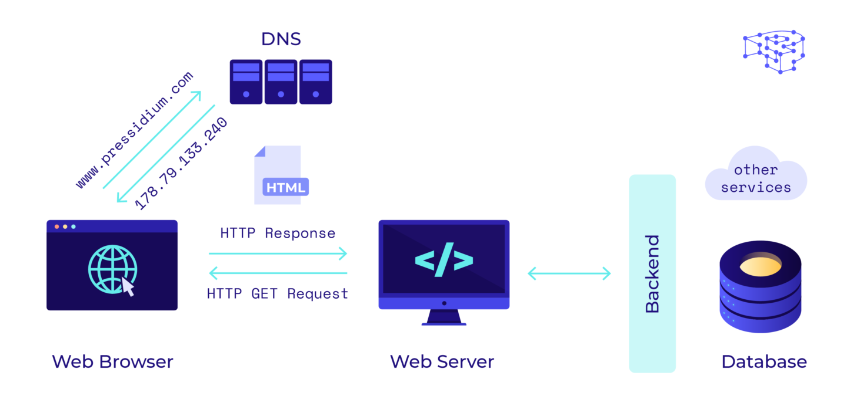
How the Internet Works ?
Step 1: You type a URL (like www.example.com) into a browser.
Step 2: Your computer sends a request to a DNS server (like a phonebook for the Internet) to find the correct IP address of the website.
Step 3: Your browser connects to the website’s server using the IP address and sends a request for the Web Page.
Step 4: The server responds by sending the webpage data back to your browser in packets.
Step 5: Your browser reassembles the data packets to display the website.

Slide 9
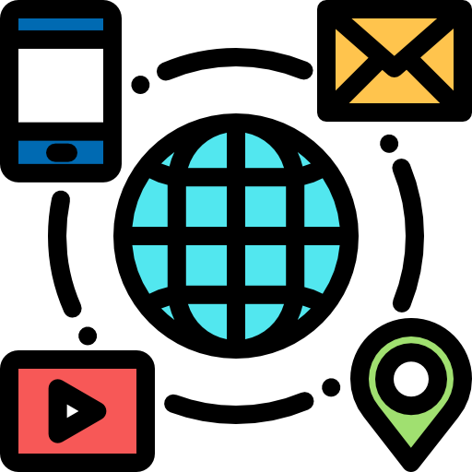
Key Terms to Remember
Network: A system that connects computers and devices for communication.
Router: A device that routes data between networks and to the Internet.
IP Address: A unique identifier for a device on a network.
Packets: Small units of data sent over a network.
Protocol: A set of rules for how data is communicated between devices (e.g., TCP/IP).

Slide 10

Conclusion
The Internet is a massive global network that connects smaller networks.
Networks can be wired or wireless and use routers, switches, and modems to communicate.
Communication happens using protocols like TCP/IP and involves sending data in packets.
In Part 2, we'll dive deeper into how the Internet connects millions of networks together.

Slide 11
Activity - MCQs
What is the primary function of the Internet?
A) To create standalone networks
B) To function as a global network connecting millions of private, public, academic, business, and government networks
C) To serve as a database for storing personal information
D) To operate as a local network within homes

Slide 12
Activity - MCQs
What type of network is typically used within a single building or campus?
A) LAN (Local Area Network)
B) WAN (Wide Area Network)
C) MAN (Metropolitan Area Network)
D) GAN (Global Area Network)

Slide 13
Activity - MCQs
Which device is primarily responsible for directing data packets between networks?
A) Router
B) Switch
C) Modem
D) Hub

Slide 14
Activity - MCQs
How do IP addresses function in a network?
A) They serve as unique identifiers allowing devices to locate and communicate with each other
B) They encrypt data for secure transmission
C) They provide a physical connection between devices
D) They store data packets temporarily

Slide 15
Activity - MCQs
What is the purpose of data packets in network communication?
A) To contain compressed data for storage
B) To carry data in a structured format across the network
C) To provide antivirus protection
D) To serve as backup copies of data

Slide 16
Activity - Answers
B) To function as a global network connecting millions of private, public, academic, business, and government networks
A) LAN (Local Area Network)
A) Router
A) They serve as unique identifiers allowing devices to locate and communicate with each other
B) To carry data in a structured format across the network

